Slide 1
Stanford ME469: Common low-Mach Discretization Approaches
Stefan P. Domino
Computational Thermal and Fluid Mechanics
Sandia National Laboratories SAND2018-4536 PE

Slide 2
Common low-Mach Discretization Approaches: Outline
The Concept of Meshing
Why Unstructured?
Unstructured Element Typoes
Finite Element Method (FEM)
Control-Volume Finite Element Method (CVFEM)
Edge-based Vertex-Centered (EBVC)
Cell-centered Finite Volume (FV)
Staggered arrangement
Conclusions

Slide 3
Introducing a Mesh over Heart Domain, Ω
Notes: Geometry is:
Complex
Curved
Sharp

Slide 4
Introducing a [Finite Difference] Mesh over Heart Domain, Ω
? What breaks..
Notes: Geometry is:
Complex
Curved
Sharp

Slide 5
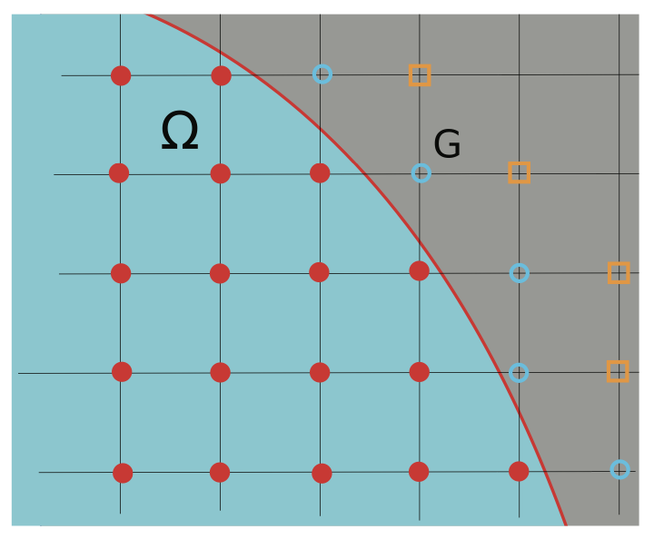
Introducing a [Finite Difference] Mesh over Heart Domain, Ω
? What breaks..
Notes: Geometry is:
Complex
Curved
Sharp
Not impossible: Chertock, et al., “A Second-Order Finite-Difference Method for Compressible Fluids in Domains with Moving Boundaries”, Commun. Comput. Phys., 2018

Slide 6
Introducing a [Structured Mesh] over Heart Domain, Ω;
Notes: Geometry is:
Complex
Curved
Sharp

Slide 7
Introducing a [Structured Mesh] over Heart Domain, Ω;
? What breaks..
Notes: Geometry is:
Complex
Curved
Sharp

Slide 8
Introducing a [Structured Mesh] over Heart Domain, Ω;
? What breaks..
Notes: Geometry is:
Complex
Curved
Sharp

Slide 9
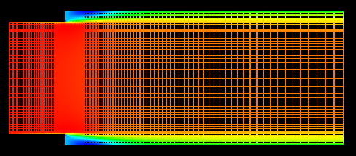
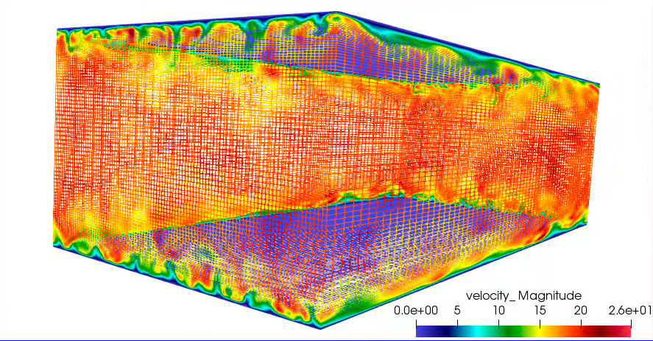
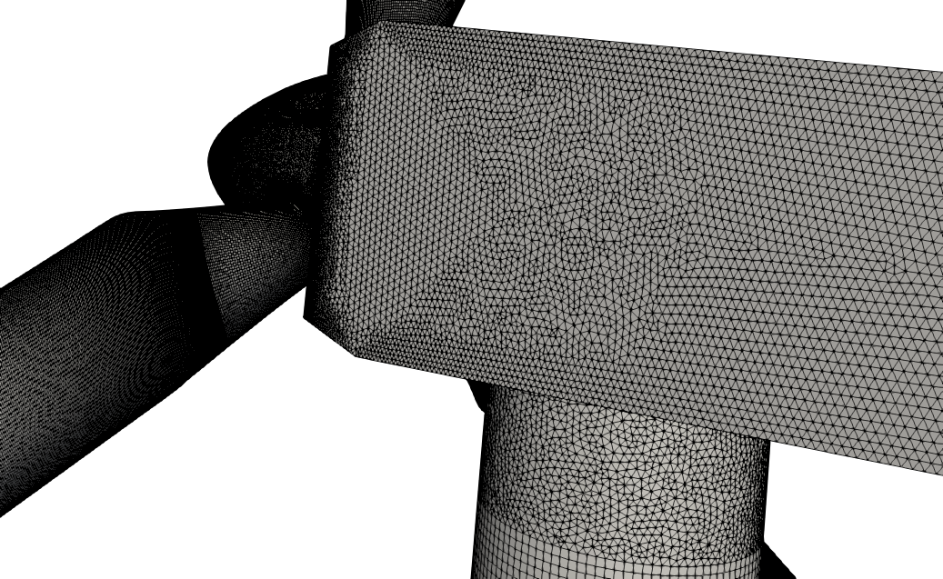
Structured vs Unstructured
Many times, the canonical flows of interest are in simplified geometries that allow for cartesian meshes – with “stair-stepping”
RANS-based backward facing step (Domino, 2012)
Re^{τ} 395 plane-channel (Jofre, Domino, Iaccarino, 2018)
Often times, not!
https://www.itascainternational.com/software/introduction-to-meshing

Slide 10
In Fairness…. The Carbon-Capture Multidisciplinary Simulation Center
15MW coal-fired boiler volume rendered image of large (90 μm) particles
Staggered schemes have been demonstrated to support complex applications
Cut-cells and embedded approaches help
http://ccmsc.utah.edu/about.html

Slide 11
Introducing a Mesh over Heart Domain, Ω
Elements of size 4 (Quad4) or 3 (Tri3) have been introduced
Exterior domain is faceted
Non-conformal interface between the Tri3 and Quad4 block
Two types of connectivity have been presented: node:element and element:face:element
Two types of integration: Ω^{e} vs Ω^{cv}

Slide 12
Introducing a Mesh over Heart Domain, Ω
Elements of size 4 (Quad4) or 3 (Tri3) have been introduced
Exterior domain is faceted
Non-conformal interface between the Tri3 and Quad4 block
Two types of connectivity have been presented: node:element and element:face:element
Two types of integration: Ω^{e} vs Ω^{cv}

Slide 13
Data Structure Ramifications
A bit more complicated….
Element and associated data structures are indexed directly via i^{th} and j^{th} location, e.g., velocity_x(i,j), over the range: velocity_x(0:nX,0:nY)
Neighbors are directly indexed, e.g,, “north” neighbor of (i,j) is (i,j+1)
Element and associated data structures are indexed indirectly via a data structure, e.g., velocity_x(k), ober the range: velocity_x(0:nElem)
Neighbors of (k) are obtained via a relationship mapping obtained, e.g.,
std::vector<int> neighbor_elems
= elem_relationship(k);

Slide 14
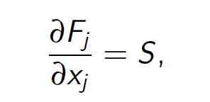
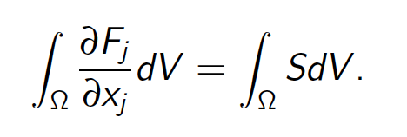
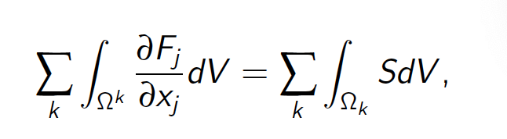
Integration Over the Domain
Consider a simple model equation with the heart domain in mind:
Integrating over the domain, Ω:
Without loss of generality, let us define a set of subdomains, Ω_{k}:
Where F_{j} is a flux and S is a source term
Note: Often the formality of Σ_{k} and Ω_{k} is dropped and is implied over the integration

Slide 15
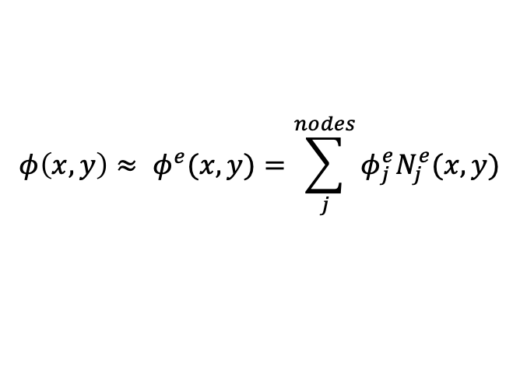
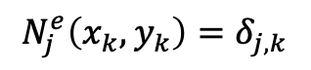
Mesh-based Methods Basic Concept: Sub-divide domain into Finite Elements and Numerically Integrate
$$φ\left(x,y\right)≈ φ^{e}(x,y)=\sum_{j}^{nodes}{φ_{j}^{e}N_{j}^{e}(x,y)}$$
Define basis within the domain:
While restricting to a Lagrange nodal basis,
$$N_{j}^{e}\left(x_{k},y_{k}\right)=δ_{j,k}$$

Slide 16
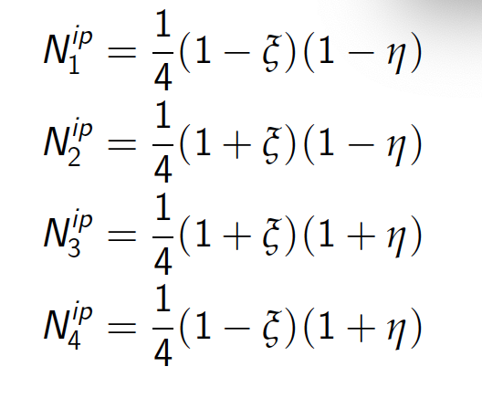
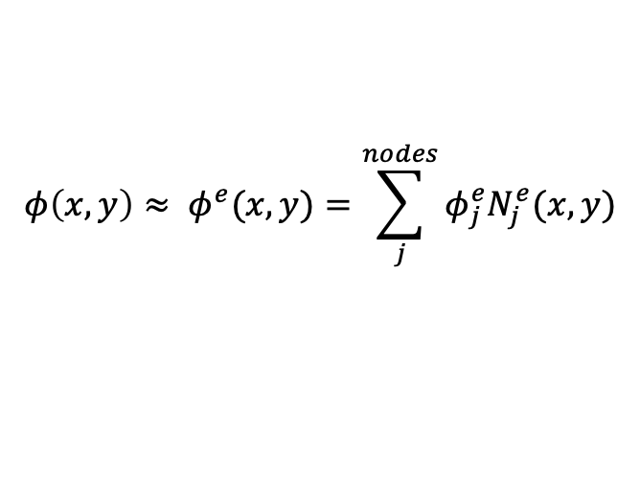
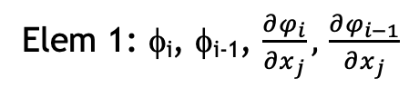
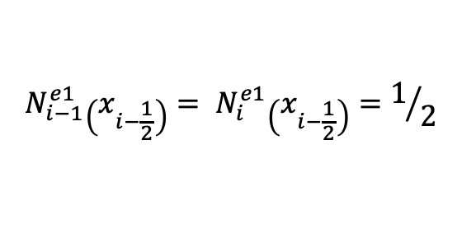
Re-visiting the Underlying Basis: Vertex-centered
Mindset change for unstructured: the mesh connectivity we have implicitly defines the limiting spatial order of the scheme, here in an unstructured setting, second-order in space
The “left”/”right” two-state scheme where i-2, and i+1 values are “reachable” through extrapolation
Later, in the advection stabilization set of lectures, we will see that such extrapolation is, often “limited”
i-2
i-1
_{i-1/2}
i
_{i+1/2}
i+1
i+2
Elem 1: φ_{i}, φ_{i-1}, $\frac{∂φ_{i}}{∂x_{j}},$ $\frac{∂φ_{i−1}}{∂x_{j}}$
Integration points
Degree-of-freedom (DOF)
$$φ\left(x,y\right)≈ φ^{e}(x,y)=\sum_{j}^{nodes}{φ_{j}^{e}N_{j}^{e}(x,y)}$$
$$N_{i−1}^{e1}\left(x_{i−\frac{1}{2}}\right)= N_{i}^{e1}\left(x_{i−\frac{1}{2}}\right)=1/2$$
Iso-parametric coordinate system: -1:+1

Slide 17
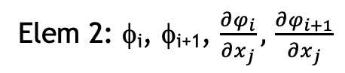
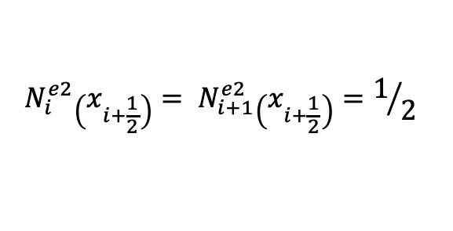
Re-visiting the Underlying Basis: Vertex-centered
Mindset change for unstructured: the mesh connectivity we have implicitly defines the limiting spatial order of the scheme, here in an unstructured setting, second-order in space
The “left”/”right” two-state scheme where i-1, and i+2 values are “reachable” through extrapolation
Later, in the advection stabilization set of lectures, we will see that such extrapolation is, often “limited”
i-2
i-1
_{i-1/2}
i
_{i+1/2}
i+1
i+2
Elem 2: φ_{i}, φ_{i+1}, $\frac{∂φ_{i}}{∂x_{j}},$ $\frac{∂φ_{i+1}}{∂x_{j}}$
Integration points
Degree-of-freedom (DOF)
$$φ\left(x,y\right)≈ φ^{e}(x,y)=\sum_{j}^{nodes}{φ_{j}^{e}N_{j}^{e}(x,y)}$$
$$N_{i}^{e2}\left(x_{i+\frac{1}{2}}\right)= N_{i+1}^{e2}\left(x_{i+\frac{1}{2}}\right)=1/2$$
Iso-parametric coordinate system: -1:+1

Slide 18
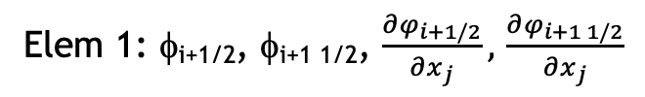
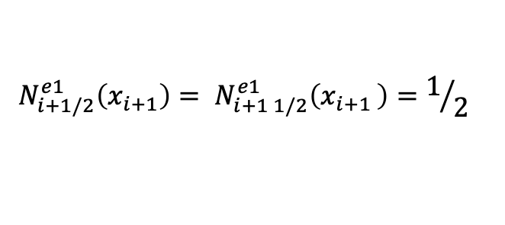
Re-visiting the Underlying Basis: Cell-centered
Mindset change for unstructured: the mesh connectivity we have implicitly defines the limiting spatial order of the scheme, here in an unstructured setting, second-order in space
The “left”/”right” two-state scheme; increased stencil “reachable” - still by extrapolation
Iterate virtual edges of control volume faces, connected to the left and right DOF location
Integration point area vector, or at the face of the elements
What might be a path forward to increase order of accuracy, while maintaining a compact stencil?
Cell-centered
i-2
i-1
_{i-1/2}
i
_{i+1/2}
i+1
i+2
Elem 1: φ_{i+1/2}, φ_{i+1 1/2}, $\frac{∂φ_{i+1/2}}{∂x_{j}},$ $\frac{∂φ_{i+1 1/2}}{∂x_{j}}$
Integration points
Degree-of-freedom (DOF)
$$φ\left(x,y\right)≈ φ^{e}(x,y)=\sum_{j}^{nodes}{φ_{j}^{e}N_{j}^{e}(x,y)}$$
$$N_{i+1/2}^{e1}\left(x_{i+1}\right)= N_{i+1 1/2}^{e1}\left(x_{i+1 }\right)=1/2$$

Slide 19
Re-visiting the Underlying Basis: Polynomial Promotion
From this:
to that….
i-2
i-1
_{i-1/2}
i
_{i+1/2}
i+1
i+2
i-1
_{i-1/2}
i
_{i+1/2}
i+1
Note:
New promoted nodes “live” at the Gauss-Lobatto points while dual volume lives at the Gauss-Lagendre points: +/- sqrt(3)/3
i-1
_{i-1/2}
i
_{i+1/2}
i+1

Slide 20

Example of a Quadratic Basis Function
1. 3. 2
3
Two-dimensional promotion

Slide 21
Example of a Quadratic Basis Function
1. 3. 2
3
Two-dimensional promotion

Slide 22
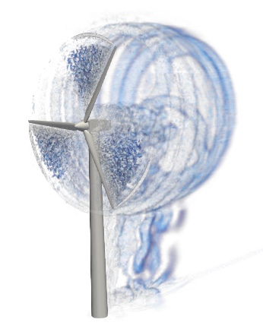
Reality: Meshing time for complex applications remains a significant bottleneck!
Many applications of interest contain complex geometries
low-Mach fluids users interested in high-quality simulation results tend towards hexahedral-based topologies (if possible)
However, if a scheme is “design-order” accurate, any topology may suffice as it is simply a matter of mesh size and efficiency – not unlike the active discussion on low- vs higher-order
Sometimes, the penetration of a low-Mach fluids physics addition in common analysis is high as the meshing can be prohibitively complex
UUR Example: Vestas V27 225 kw hybrid low-order hex/tet/pyr/wedge
Very complex world – stair-stepped!

Slide 23
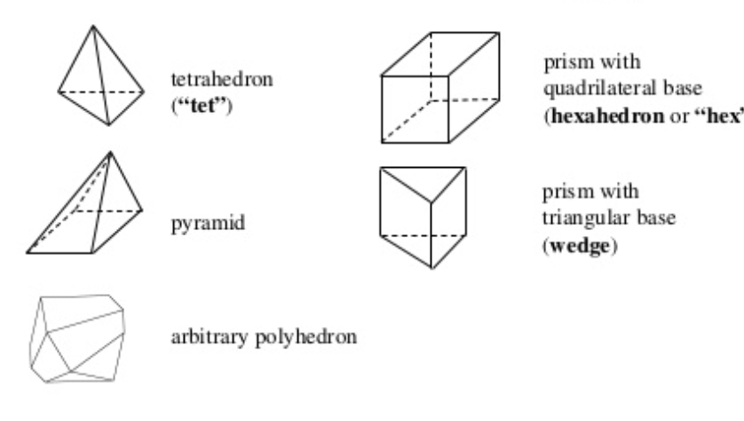
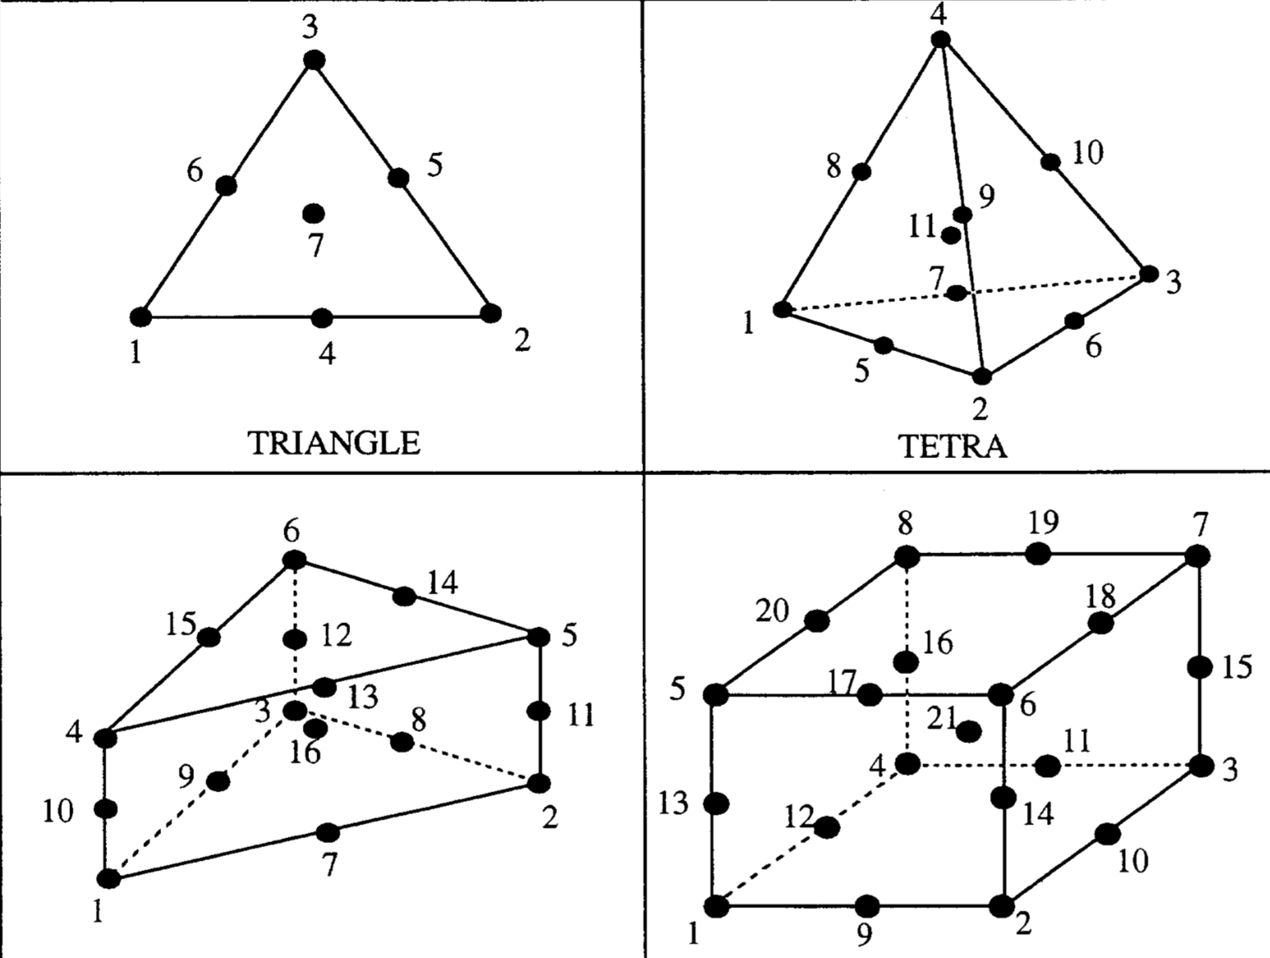
Examples of Various Topologies
Hex8
Tet4
Pyramid5
Wedge6
Arbitrary
Higher-order promoted elements (Hex27, Tet10, Wedge16, Hex64, etc.)

Slide 24
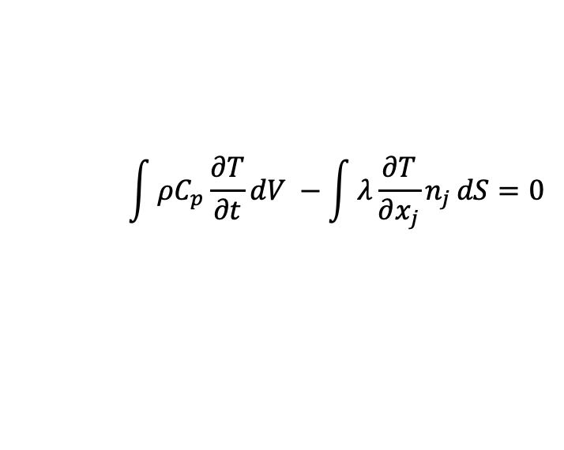
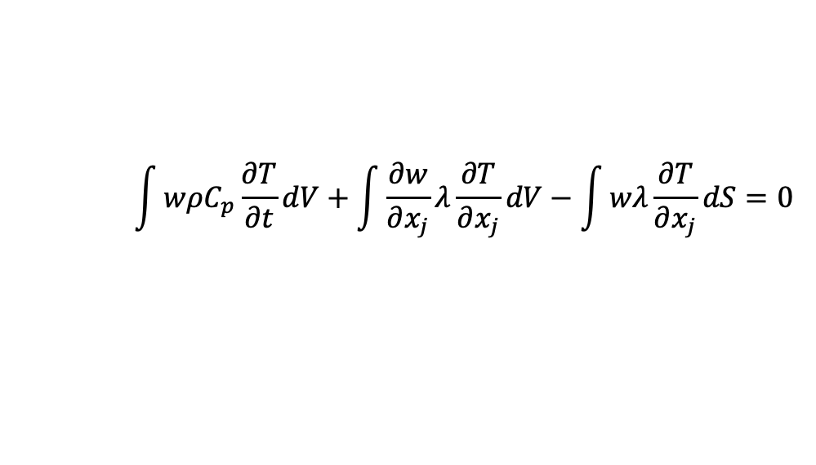
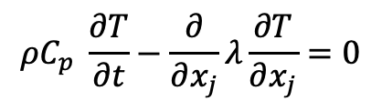
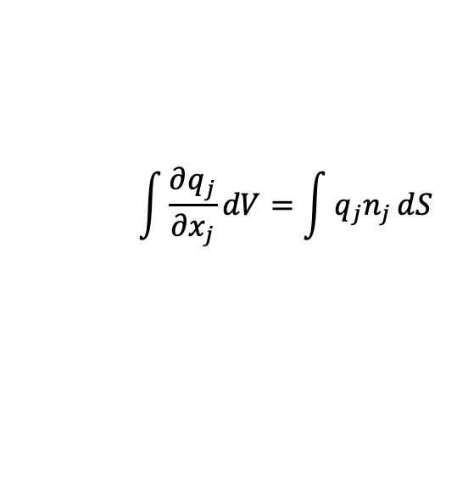
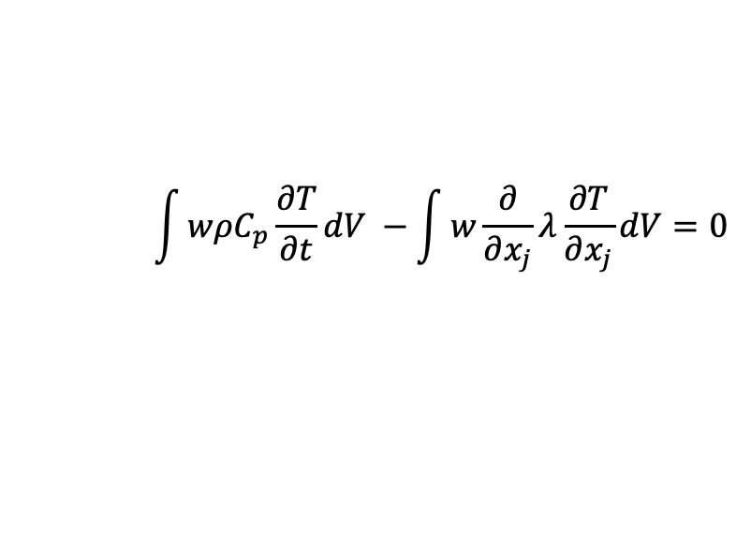
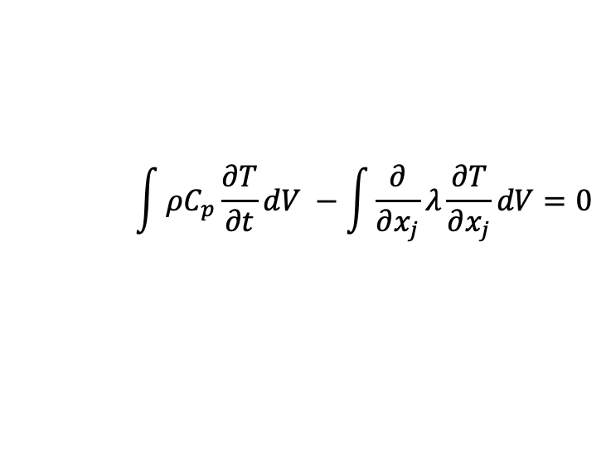
Fundamentals of Discretization (Review)
Given a partial differential equation (PDE) and associated volumetric form:
Applying Gauss Divergence provides the standard finite volume form:
We can also multiple PDE by an arbitrary test function, w, and integrate over a volume,
$$ρC_{p} \frac{∂T}{∂t}−\frac{∂}{∂x_{j}}λ\frac{∂T}{∂x_{j}}=0$$
$$\int{ρC_{p}\frac{∂T}{∂t}dV −\int{\frac{∂}{∂x_{j}}λ\frac{∂T}{∂x_{j}}}dV=0}$$
$$\int{\frac{∂q_{j}}{∂x_{j}}dV=\int{q_{j}n_{j}}dS}$$
$$\int{ρC_{p}\frac{∂T}{∂t}dV −\int{λ\frac{∂T}{∂x_{j}}n_{j}}dS=0}$$
Next, integrate by parts and apply
Gauss-Divergence. Note, that test function must be differentiable – shown here, at least once..
$$\int{wρC_{p}\frac{∂T}{∂t}dV −\int{w\frac{∂}{∂x_{j}}λ\frac{∂T}{∂x_{j}}}dV=0}$$
$$\int{wρC_{p}\frac{∂T}{∂t}dV+\int{\frac{∂w}{∂x_{j}}λ\frac{∂T}{∂x_{j}}}dV−\int{wλ\frac{∂T}{∂x_{j}}}dS=0}$$
Sometimes, one notes T as T^{h} - the trial space on given mesh size, h

Slide 25
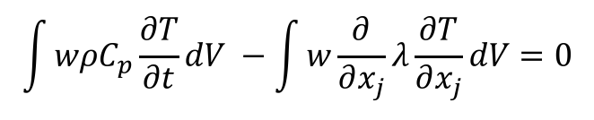
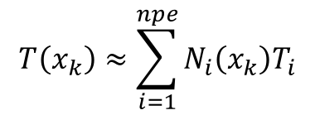
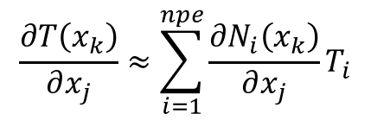
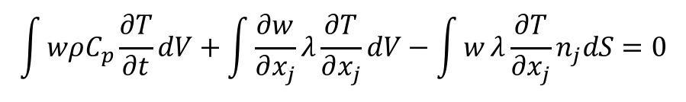
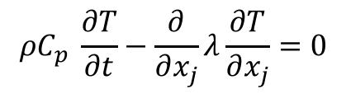
The Finite Element Method (FEM)
Consider the example in which the finite element method (FEM) is employed
Define an underlying nodal basis with the element:
Gaussian Quadrature is used
using a -1:1 range, +/- sqrt(3)/3
Consider a simple heat conduction model PDE,
Integrate using a test function,
Integration-by-parts (with G-D) provides:
Iterate element quadrature points
Note that N can be arbitrary in order (shown here for a linear)
$$T\left(x_{k}\right)≈\sum_{i=1}^{npe}{N_{i}\left(x_{k}\right)T_{i}}$$
$$\frac{∂T\left(x_{k}\right)}{∂x_{j}}≈\sum_{i=1}^{npe}{{\frac{∂N_{i}\left(x_{k}\right)}{∂x_{j}}T}_{i}}$$
$$ρC_{p} \frac{∂T}{∂t}−\frac{∂}{∂x_{j}}λ\frac{∂T}{∂x_{j}}=0$$
$$\int{wρC_{p}\frac{∂T}{∂t}dV −\int{w\frac{∂}{∂x_{j}}λ\frac{∂T}{∂x_{j}}}dV=0}$$
$$\int{wρC_{p}\frac{∂T}{∂t}dV+\int{\frac{∂w}{∂x_{j}}λ\frac{∂T}{∂x_{j}}}dV−\int{w}λ\frac{∂T}{∂x_{j}}n_{j}dS=0}$$

Slide 26
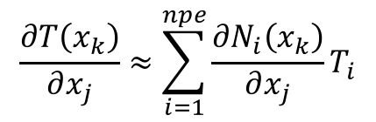
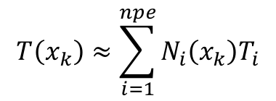
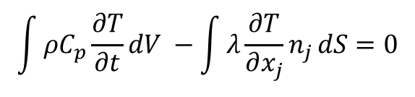
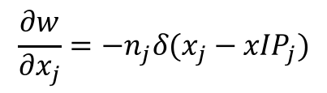
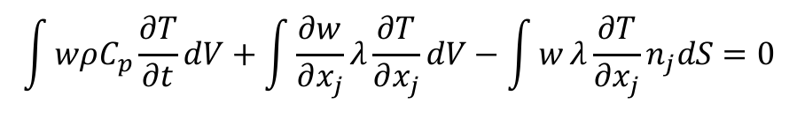
The Hybrid Control-Volume Finite Element Method (CVFEM)
A combination between a vertex-centered finite volume and FEM is the method known as Control Volume Finite Element
A dual mesh is constructed to obtain flux and volume quadrature locations
As with FEM, a basis is defined:
$$T\left(x_{k}\right)≈\sum_{i=1}^{npe}{N_{i}\left(x_{k}\right)T_{i}}$$
$$\frac{∂T\left(x_{k}\right)}{∂x_{j}}≈\sum_{i=1}^{npe}{{\frac{∂N_{i}\left(x_{k}\right)}{∂x_{j}}T}_{i}}$$
Integration-by-parts over test function w:
However, define a test function, w, as a piece-wise constant function (Heaviside) to be 1 inside the dual volume and 0 outside. Gradient is a Dirac-delta function:
Leading to:
$$\int{wρC_{p}\frac{∂T}{∂t}dV+\int{\frac{∂w}{∂x_{j}}λ\frac{∂T}{∂x_{j}}}dV−\int{w}λ\frac{∂T}{∂x_{j}}n_{j}dS=0}$$
$$\frac{∂w}{∂x_{j}}=−n_{j}δ(x_{j}−{xIP}_{j})$$
$$\int{ρC_{p}\frac{∂T}{∂t}dV −\int{λ\frac{∂T}{∂x_{j}}n_{j}}dS=0}$$
Dual-volume definition

Slide 27
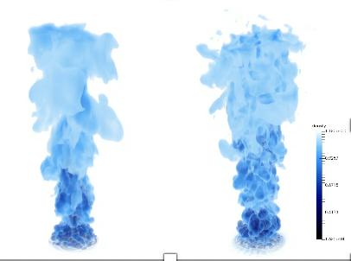
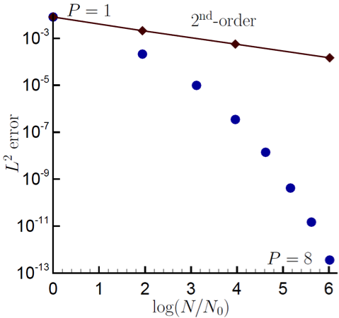
Control-Volume Finite Element Method Attributes
The CVFEM method, therefore, is a finite volume scheme that is locally conservative, i.e., momentum leaving one dual volume face enters the adjacent dual volume
However, the diffusion operator, like its FEM counterpart is absent of any error due to non-orthogonality
Suffers on high-aspect ratio meshes in presence of high gradients: sqrt(3)
Since the test-function, w, is different from the underlying basis representation, this method can be considered a Petrov-Galerkin method
The method can also be promoted in polynomial space (first fluids: Domino, 2014)
P=1 (left) and P=4 (right)
Helium plume (VR-density)
Spectral convergence
Dual-volume for promoted quad4

Slide 28
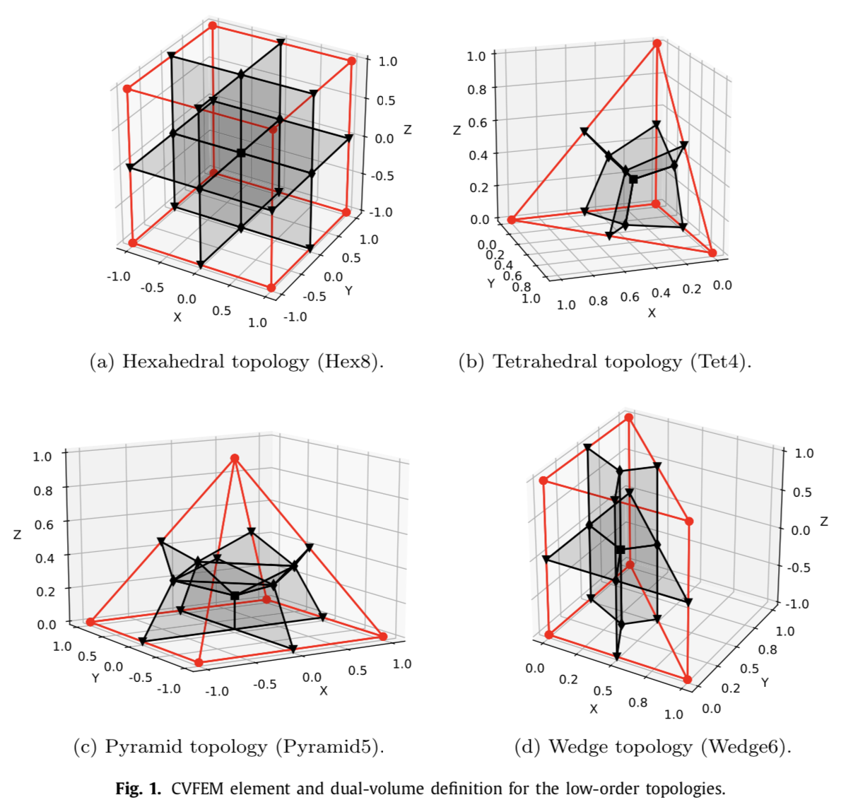
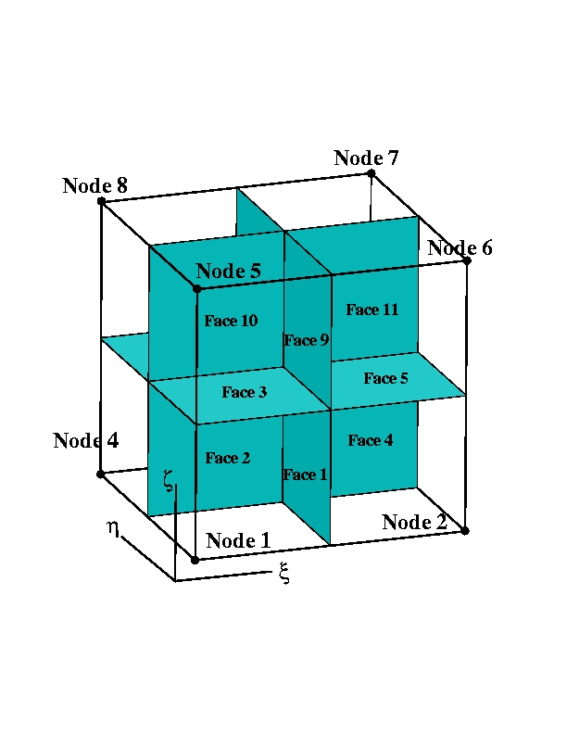
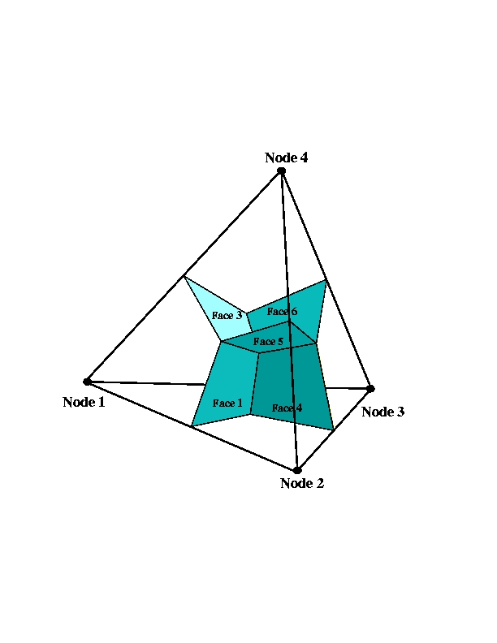
Dual Volume Definitions for Hybrid Meshes
Domino, et. al, “An assessment of atypical mesh topologies for low-Mach large-eddy simulation” 2019

Slide 29
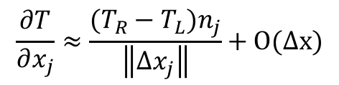
Equal Order Interpolation Edge-Based Vertex-Centered (EBVC) Finite Volume
All primitives are collocated at the vertices of the elements with equal-order interpolation
A dual mesh is constructed to obtain flux and volume quadrature locations
Classic two-state, “L” and “R” approach provides spatially second-order accuracy
Surface quadrature point (area summed to edge)
Volume quadrature point (sub-vol summed to node)
Same grad-op as CC:
Iterate nodes for volume contributions
Iterate edges for surface flux contribution
$$\frac{∂T}{∂x_{j}}≈\frac{(T_{R}−T_{L})n_{j}}{\left\|{Δx}_{j}\right\|}+O(∆x)$$
T_{L}
n_{j}
T_{R}
Dual-volume definition
Edge-based stencil

Slide 30
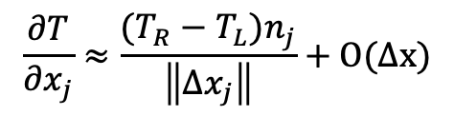
Equal Order Interpolation Edge-Based Vertex-Centered (EBVC) Finite Volume
All primitives are collocated at the vertices of the elements with equal-order interpolation
A dual mesh is constructed to obtain flux and volume quadrature locations
Classic two-state, “L” and “R” approach provides spatially second-order accuracy
Surface quadrature point (area summed to edge)
Volume quadrature point (sub-vol summed to node)
Same grad-op as CC:
Iterate nodes for volume contributions
Iterate edges for surface flux contribution
$$\frac{∂T}{∂x_{j}}≈\frac{(T_{R}−T_{L})n_{j}}{\left\|{Δx}_{j}\right\|}+O(∆x)$$
T_{L}
n_{j}
T_{R}
Dual-volume definition
Edge-based stencil

Slide 31
Equal Order Interpolation Edge-Based Vertex-Centered (EBVC) Finite Volume
All primitives are collocated at the vertices of the elements with equal-order interpolation
A dual mesh is constructed to obtain flux and volume quadrature locations
Classic two-state, “L” and “R” approach provides spatially second-order accuracy
Surface quadrature point (area summed to edge)
Volume quadrature point (sub-vol summed to node)
Same grad-op as CC:
Iterate nodes for volume contributions
Iterate edges for surface flux contribution
Dual nodal volume
$$\frac{∂T}{∂x_{j}}≈\frac{(T_{R}−T_{L})n_{j}}{\left\|{Δx}_{j}\right\|}+O(∆x)$$
Area vector
T_{L}
n_{j}
T_{R}
Dual-volume definition
Edge-based stencil

Slide 32
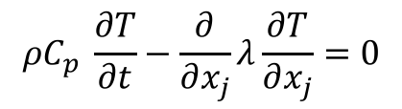
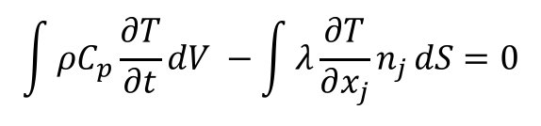
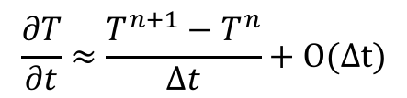
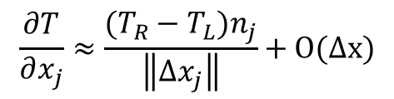
Equal-Order Interpolation Cell-Centered (CC) Finite Volume
All primitives are collocated at the cell-center of the element with equal-order interpolation
Classic two-state, “L” and “R” approach provides spatially second-order accuracy
Consider a simple heat conduction model PDE,
Integrate over a control volume and use Gauss-Divergence,
Iterate element cell-centers for volume contributions (time/source)
Iterate element faces for surface flux contribution
Surface
quadrature point
$$ρC_{p} \frac{∂T}{∂t}−\frac{∂}{∂x_{j}}λ\frac{∂T}{∂x_{j}}=0$$
T_{L}
T_{R}
$$\int{ρC_{p}\frac{∂T}{∂t}dV −\int{λ\frac{∂T}{∂x_{j}}n_{j}}dS=0}$$
n_{j}
$$\frac{∂T}{∂x_{j}}≈\frac{(T_{R}−T_{L})n_{j}}{\left\|{Δx}_{j}\right\|}+O(∆x)$$
with:
$$\frac{∂T}{∂t}≈\frac{T^{n+1}−T^{n}}{Δt}+O(∆t)$$

Slide 33
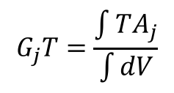
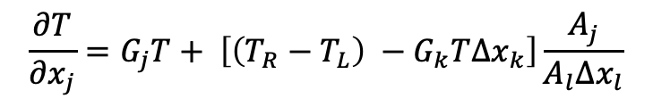
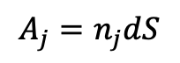
Typical Failings for Two-State Discretization Methods
With two points, only a linear basis can be used.
Therefore, unstructured CC and EBVC are limited to second-order spatial accuracy
Non-orthogonality is problematic for gradient-operator
Above, G_{j}T is a projected nodal gradient at the cell-center, or vertex center:
Non-orthogonality is simply defined as the mis-alignment of the distance vector between the two ”L” and “R” states and the surface normal
Both edge- and cell centered-based schemes show degraded accuracy on typical production meshes
Several non-orthogonality approaches are available, for the best source, see Jasak
Jasak, “Error analysis and error estimation for the finite volume method with applications to fluid flow”, Imperial College Dissertation, 1996
One Significant Advantage: Monotonicity preserving on high-aspect ratio meshes…
$$\frac{∂T}{∂x_{j}}=G_{j}T+ \left[\left(T_{R}−T_{L}\right) −G_{k}T∆x_{k}\right]\frac{A_{j}}{A_{l}∆x_{l}}$$
Δx_{j}
n_{j}
With area vector defined by:
$$A_{j}=n_{j}dS$$
$$G_{j}T=\frac{\int{TA_{j}}}{\int{dV}}$$

Slide 34
Classic Staggered Finite Volume
Stencil for CC-quantities
Stencil for x-velocity
Stencil for y-velocity
Velocity degree-of-freedom is staggered relative to pressure and other primitives, e.g., enthalpy, mixture fraction, etc.
P_{N}
P_{S}

Slide 35
Attributes of a Staggered Scheme
By design, non-orthogonality is absent, however, complex geometry will be stair-stepped
From a fluids perspective, the operators are ideal, i.e., pressure gradient for momentum is compact, e.g., (P_{E} – P_{W})Δx⁻¹
As will be seen in future lecture topics, the skew-adjoint nature of the Divergence operator, D, and Gradient operator, G, allows for a Laplace operator, L = DG
Can be extended to higher-order
Frequently, meshing complex geometries can be extremely difficult (consider our V27 example)

Slide 36
An Informal Survey….
Cell-Centered: (Sometimes generalized Polyhedra)
Ansys Fluent, OpenFOAM (FireFOAM, NavyFOAM), CD-Adapco (Star-CCM), Soleil-X (Stanford)
EBVC: (Most typical in the acoustically compressible space)
SU2, FUN3D, CHAD, Nalu-Wind (production), Nalu (option to explore discretizations)
CVFEM
Fluent (originally!), CFX-TASC-FLOW, Sierra Fuego (SNL), Nalu
FEM
FIDAP, COMSOL, EDDY (NASA), AcuSim, PHASTA
Staggered
Arches (Utah)

Slide 37
An Informal Survey….
Cell-Centered: (Sometimes generalized Polyhedra)
Ansys Fluent, OpenFOAM (FireFOAM, NavyFOAM), CD-Adapco (Star-CCM), Soleil-X (Stanforf)
EBVC: (Most typical in the acoustically compressible space)
SU2, FUN3D, CHAD, Nalu-Wind (production), Nalu (option to explore discretizations)
CVFEM
Fluent (originally!), CFX-TASC-FLOW, Sierra Fuego (SNL), Nalu
FEM
FIDAP, COMSOL, EDDY (NASA), AcuSim, PHASTA
Staggered
Arches (Utah)
Common Water-Cooler CFD Arguments:
Structured vs. Un-structured
FEM vs. Finite Volume
Node-centered vs. Cell-centered
Monolithic vs. Operator Split
Compressible vs. (acoustically) Incompressible
Explicit vs. Implicit

Slide 38

An Informal Survey….
Cell-Centered: (Sometimes generalized Polyhedra)
Ansys Fluent, OpenFOAM (FireFOAM, NavyFOAM), CD-Adapco (Star-CCM), Soleil-X (Stanforf)
EBVC: (Most typical in the acoustically compressible space)
SU2, FUN3D, CHAD, Nalu-Wind (production), Nalu (option to explore discretizations)
CVFEM
Fluent (originally!), CFX-TASC-FLOW, Sierra Fuego (SNL), Nalu
FEM
FIDAP, COMSOL, EDDY (NASA), AcuSim, PHASTA
Staggered
Arches (Utah)
Common Water-Cooler CFD Arguments:
Structured vs. Un-structured
FEM and Finite Volume
Node-centered vs. Cell-centered
Monolithic and Operator Split
Compressible vs. (acoustically) Incompressible
Explicit and Implicit

Slide 39


Hybrid Meshes, Even for LES!
Hybrid mesh study based on Ham and Iaccarino, CTR Annual Brief, 2006, found that simulations were extremely sensitive to mesh topology
Non-symmetric time mean flow found for cell-centered; better for the CTR node-centered formulation
Native CVFEM and EBVC are both symmetric in mean quantities
T
B
Domino, et. al, “The suitability of hybrid meshes for low-Mach large-eddy simulation” Stanford CTR Summer Program, 2018

Slide 40



Recent Generalized Unstructured Findings
Domino, et. al, “An assessment of atypical mesh topologies for low-Mach large-eddy simulation” 2019

Slide 41
A Note on Parallelism… Vertex-based
Sierra Toolkit/Standard Ownership rules: Mesh object (nodes, edges, faces, elements) owned by lower-rank. For example:
P0 locally owns E1 and nodes 1, 2, 4, and 5
P1 locally owns E2, E3, and E4 and nodes 3, 6, 7, 8, and 9
P0 and P1 share nodes 2, 4, and 5
Desired Control-Volume Finite Element (CVFEM) Operation:
“nodal volume” assemble for node 5 via iteration of each 1cmx1cm element. Desired nodal volume for node 5 = 1 cm² exactly the same on both parallel ranks
Options:
1. Iterate over locally owned elements and locally accumulate nodal volume field followed by a parallel sum and copy owned to shared.
2. Ghost element E2, E3, and E4 to P0 and E1 to P1 (along with coordinates) and iterate locally owned and ghosted elements. Locally accumulate nodal volume field followed by a copy owned to shared.
P0
1
2
3
face 1
E1
E2
4
edge 1
5
edge 2
6
E3
E4
7
8
P1
9

Slide 42
A Note on Parallelism… Vertex-based
Sierra Toolkit/Standard Ownership rules: Mesh object (nodes, edges, faces, elements) owned by lower-rank. For example:
P0 locally owns E1 and nodes 1, 2, 4, and 5
P1 locally owns E2, E3, and E4 and nodes 3, 6, 7, 8, and 9
P0 and P1 share nodes 2, 4, and 5
Desired Control-Volume Finite Element (CVFEM) Operation:
“nodal volume” assemble for node 5 via iteration of each 1cmx1cm element. Desired nodal volume for node 5 = 1 cm² exactly the same on both parallel ranks
Options:
1. Iterate over locally owned elements and locally accumulate nodal volume field followed by a parallel sum and copy owned to shared.
2. Ghost element E2, E3, and E4 to P0 and E1 to P1 (along with coordinates) and iterate locally owned and ghosted elements. Locally accumulate nodal volume field followed by a copy owned to shared.
P0
1
2
3
face 1
E1
E2
¼
¼
4
edge 1
5
edge 2
6
¼
¼
E3
E4
7
8
P1
9

Slide 43
A Note on Parallelism… Aura-based; View from P0
P0
1
2
3
E1
E2
4
5
6
E3
E4
7
8
P1
9
Ghost P1 -> P0

Slide 44
A Note on Parallelism… Aura-based; View from P1
P0
1
2
3
E1
E2
4
5
6
E3
E4
7
8
P1
9
Ghost P0 -> P1

Slide 45
Common low-Mach Discretization Approaches: Conclusions
Two-state methods, e.g., cell-centered and EBVC are attractive due to simplicity, however, suffer from non-orthogonality issues in the diffusion operator
Generally, CC or EBVC is 2x faster on a given mesh size
Less accurate/stable on generalized unstructured mesh topologies
Better diffusion operator on high-aspect ratio meshes
Simple, single topology (virtual-, or full-edge)
FEM provides a machinery to provide accurate discretizations on non-ideal meshes, however, the same diffusion operator suffers on high-aspect ratio meshes
CVFEM is a hybrid method that contains the likeable attributes of both FV and FEM (same high-aspect ratio diffusion operator finding)
Staggered arrangement is well suited for a class of fluid mechanics applications where low-order or simple geometries are found
Examples for time/source/advection and diffusion provided for EBVC, CVFEM, and FEM
Recall that Nalu iterates over locally-owned mesh objects as apposed to local+ghosted
This is a choice; however, the STK infrastructure allows for both approaches
Test yourself on a dual nodal volume assembly?

